Slide 1
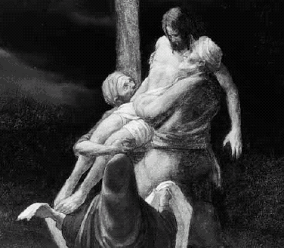
The Arimathean
Written, composed and performed by
Rev. Martin A. Shrout

Slide 2
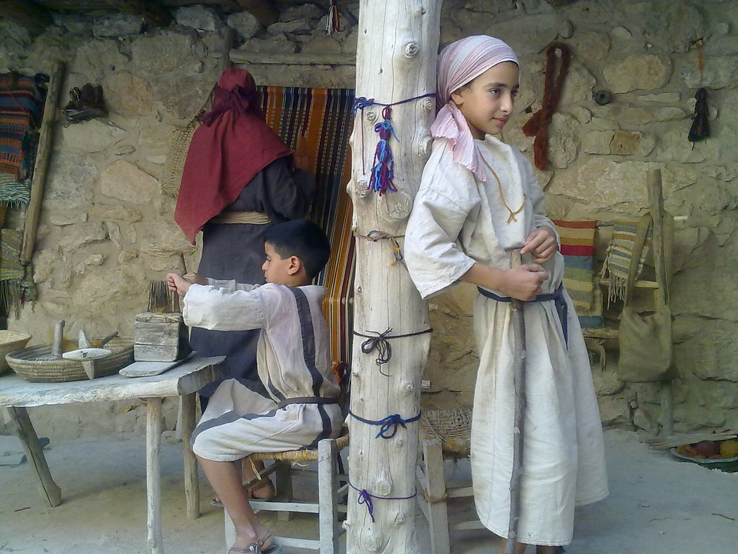
Boyhood Jealousy

Slide 3
I met him at the temple,
He asked questions of the law.
Though each question was simple,
The deeper meaning, we all saw.
When we questioned him,
His depth was undeniable.
The answers that he gave,
We’re completely justifiable.

Slide 4
Watch out for this boy,
When he grows to be a man.
Watch out for this boy,
On him God has his hand.
Watch out for this boy,
Deep wisdom for a young man.
Watch out for this boy,
He understands God‘s plan.

Slide 5
As my father spoke,
How impressed He seemed to be.
His interest caused me concern,
And I was filled with jealousy.
Who cares about this young man,
Aren’t you proud of me?
I’ll keep a watch for this boy,
If only to protect me.

Slide 6
Watch out for this boy,
When he grows to be a man.
Watch out for this boy,
On him God has his hand.
Watch out for this boy,
Deep wisdom for a young man.
Watch out for this boy,
He understands God‘s plan.

Slide 7
I’ve never met him,
How could I hate him so?
My father should see me,
And let this boy Go!

Slide 8
Watch out for this boy,
When he grows to be a man.
Watch out for this boy,
On him God has his hand.
Watch out for this boy,
Deep wisdom for a young man.
Watch out for this boy,
He understands God‘s plan.

Slide 9
He understands
He understands
God’s plan

Slide 10
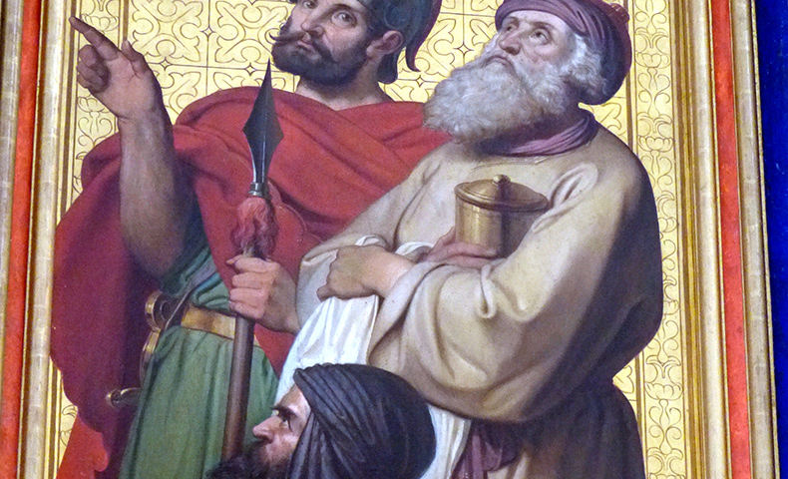
Friends Discover Jesus

Slide 11

Who Is this man?
Who walks upon the water.
Who is this man?
Who calms the raging sea.
Who is this man
who heals the broken hearted.
Who is this man?
Who heals this heart inside me.

Slide 12
Did you hear him speak,
Just the other day?
His words rang true
He’s showing a new way.
Healed a blind man
Born that way.
Who is this man
Who can say?

Slide 13
Who Is this man?
Who walks upon the water.
Who is this man?
Who calms the raging sea.
Who is this man
who heals the broken hearted.
Who is this man?
Who heals this heart inside me.

Slide 14
He fed five thousand,
Healed a man with leprosy.
He summed up the commandments,
Into two without heresy.
He spoke of a father,
And claimed himself to be.
The only Son of God .
How can he claim to be?

Slide 15
Who Is this man?
Who walks upon the water.
Who is this man?
Who calms the raging sea.
Who is this man
who heals the broken hearted.
Who is this man?
Who heals this heart inside me.

Slide 16
We know he’s of heaven
We see a man of God
Is he what he claims to be
The only son of God.

Slide 17
Who Is this man?
Who walks upon the water.
Who is this man?
Who calms the raging sea.
Who is this man
who heals the broken hearted.
Who is this man?
Who heals this heart inside me.
Who heals this heart inside me.

Slide 18
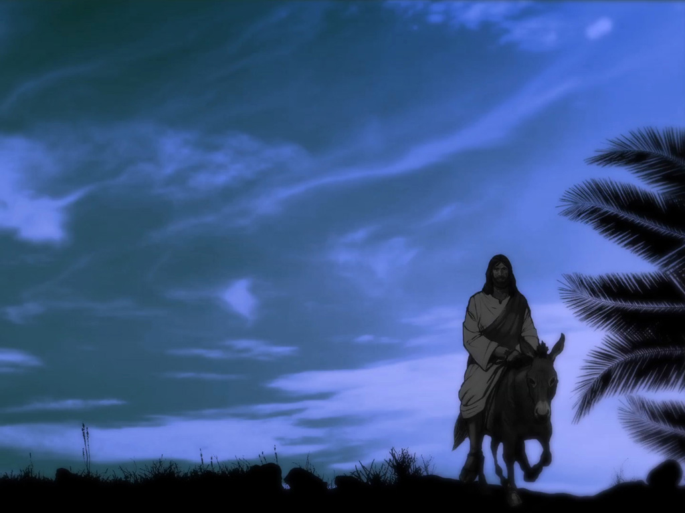
The Arrival of the King

Slide 19
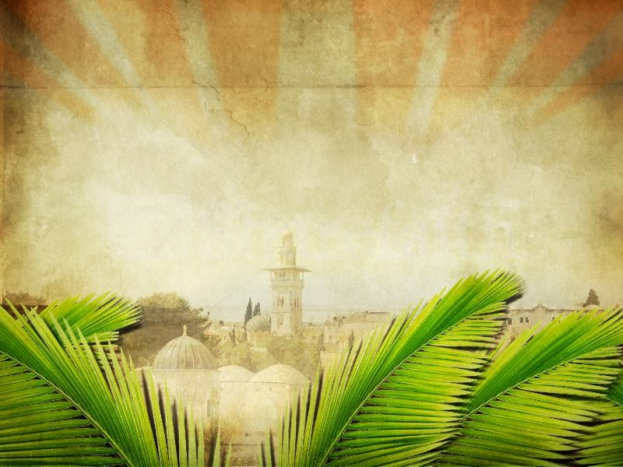
The excitement fills the air
For the arrival of the king
The crowd begins to shout Hosanna!
Is what they love sing!

Slide 20
He is my king, He is my lord
He is the one I’ve come to adore
Blessed is He who comes,
the king in God’s name!
He is my Rock, He is my Joy
He is the one I’ve come to praise
He is my king, He comes to save
From now and forevermore.

Slide 21
See the rider, so gentle and mild
He has come to set us free
Welcome the king with faith like a child
In your heart He’ll set you free

Slide 22
He is my king, He is my lord
He is the one I’ve come to adore
Blessed is He who comes,
the king in God’s name!
He is my Rock, He is my Joy
He is the one I’ve come to praise
He is my king, He comes to save
From now and forevermore.

Slide 23
With anxious hope,
they wave palm branches
As the savior draws near
Children singing songs of praises
For our redeemer who’s so dear

Slide 24
He is my king, He is my lord
He is the one I’ve come to adore
Blessed is He who comes,
the king in God’s name!
He is my Rock, He is my Joy
He is the one I’ve come to praise
He is my king, He comes to save
From now and forevermore.

Slide 25
He is my Rock, He is my Joy
He is the one I’ve come to praise
He is my king, He comes to save
From now and forevermore
From now and forevermore
He is my king!
He is my king!

Slide 26
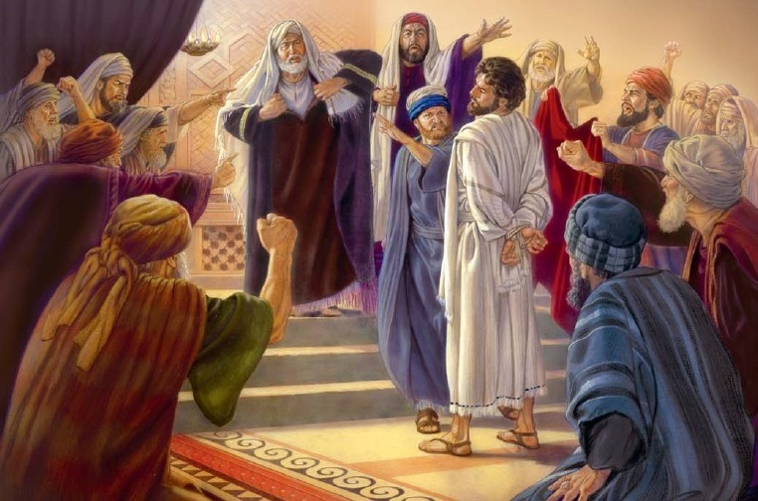
Time to Speak Up

Slide 27
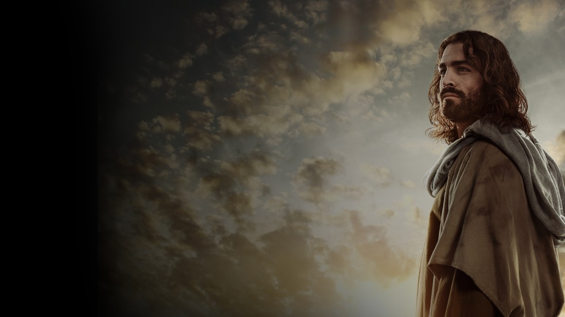
You bring this man before us,
with no evidence of his crime.
You shout out accusations,
your anger resumes its climb.
You claim that he’s been planning,
To tear down our holy temple.
Rebuilding in three days,
You know it’s not that simple.

Slide 28
He’s innocent
Your shouts are just lies
He’s innocent
Too long I’ve been too shy
He’s innocent
You just can’t crucify!
He’s innocent
Don’t let this man die

Slide 29
In the temple you
heard him speak,
You had your chance to
change his mind.
Your arguments were too weak,
To the truth you’ve been blind!
The witnesses you bring here
Speak nothing but lies.
You’re striking out in fear
Don’t you hear my urgent cry?

Slide 30
He’s innocent
Your shouts are just lies
He’s innocent
Too long I’ve been too shy
He’s innocent
You just can’t crucify!
He’s innocent
Don’t let this man die

Slide 31
I’ve hid in the shadows
For fear I’d be rejected
You’re out of control
You’ve gone farther than I expected

Slide 32
He’s innocent
Your shouts are just lies
He’s innocent
Too long I’ve been too shy
He’s innocent
You just can’t crucify!
He’s innocent
Don’t let this man die

Slide 33
He’s innocent
Oh, He’s innocent
He’s innocent
Oh, He’s innocent

Slide 34
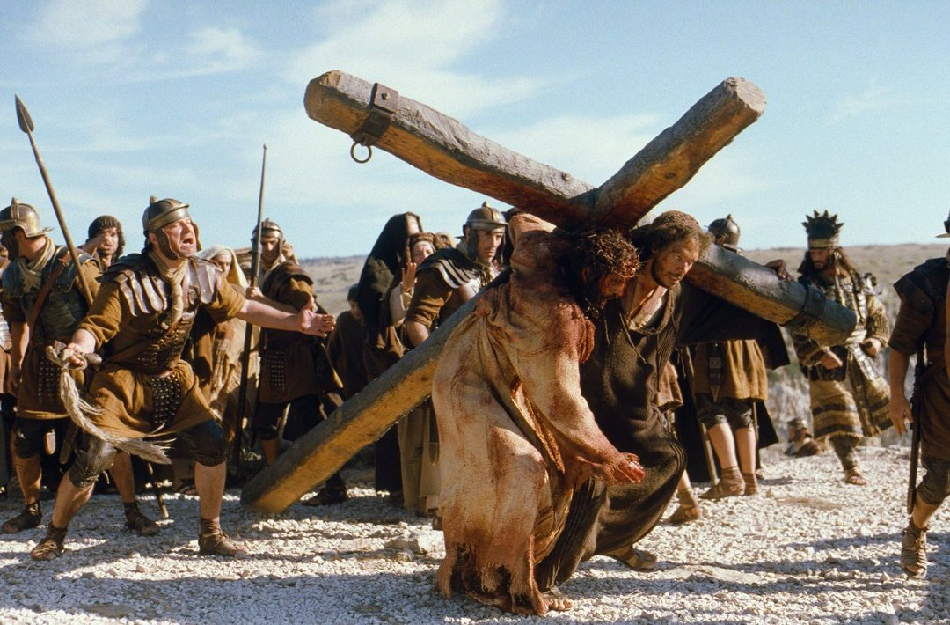
Cruel and Unusual Punishment

Slide 35
Video: Forgiven

Slide 36
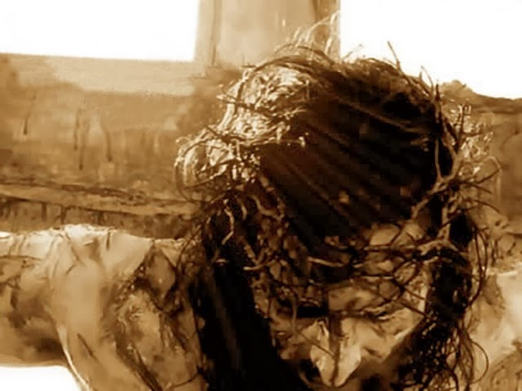
The Bloody Business of Burial

Slide 37
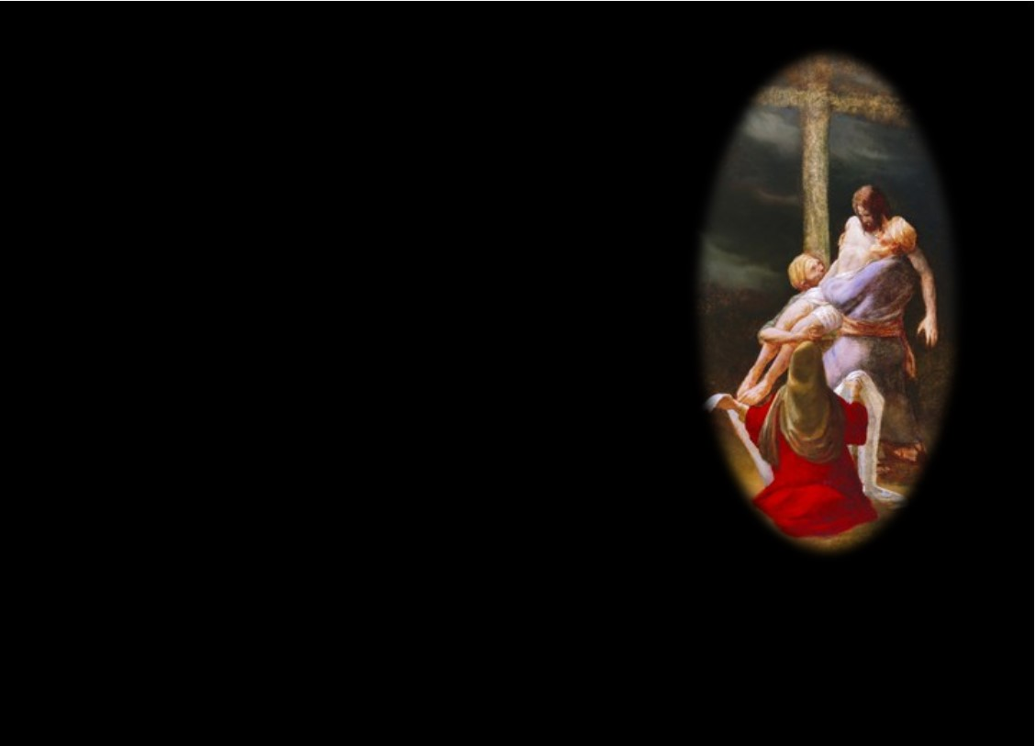
I asked Pilate for His body,
And then I took
His body down.
As I arrived at Calvary,
My heart broke for
what I found.

Slide 38
His lifeless body
upon the cross.
Removing His hands
from the nails,
Broken hearted
I felt such loss.
Covered in blood,
my face now pale.

Slide 39
I carried His body,
And now He carries me.
I took Him off the cross,
From my sins I’m
now set free.
He rose on the third day,
With pow’r and victory!
I carried his body,
And now He carries me.

Slide 40
I held his body
in my arms,
Innocence who
died for me.
My sin had caused
all this harm,
That's why he
died at Calvary.

Slide 41
This painful task
made me weep.
Life’s creator,
now void of life.
Now this memory
haunts my sleep;
As I dream of that night.

Slide 42
I carried His body,
And now He carries me.
I took Him off the cross,
From my sins I’m
now set free.
He rose on the third day,
With pow’r and victory!
I carried his body,
And now He carries me.

Slide 43
I carried his body,
I held him in my arms.
That moment of agony,
strikes deep within my heart.

Slide 44
I carried his body,
I placed the cloth
on his head.
Rolled the stone
and closed the tomb,
All because I thought
He was dead.

Slide 45
I carried His body,
And now He carries me.
I took Him off the cross,
From my sins I’m
now set free.
He rose on the third day,
With pow’r and victory!
I carried his body,
And now He carries me.
And now He carries me.

Slide 46
Dark Night In Waiting

Slide 47
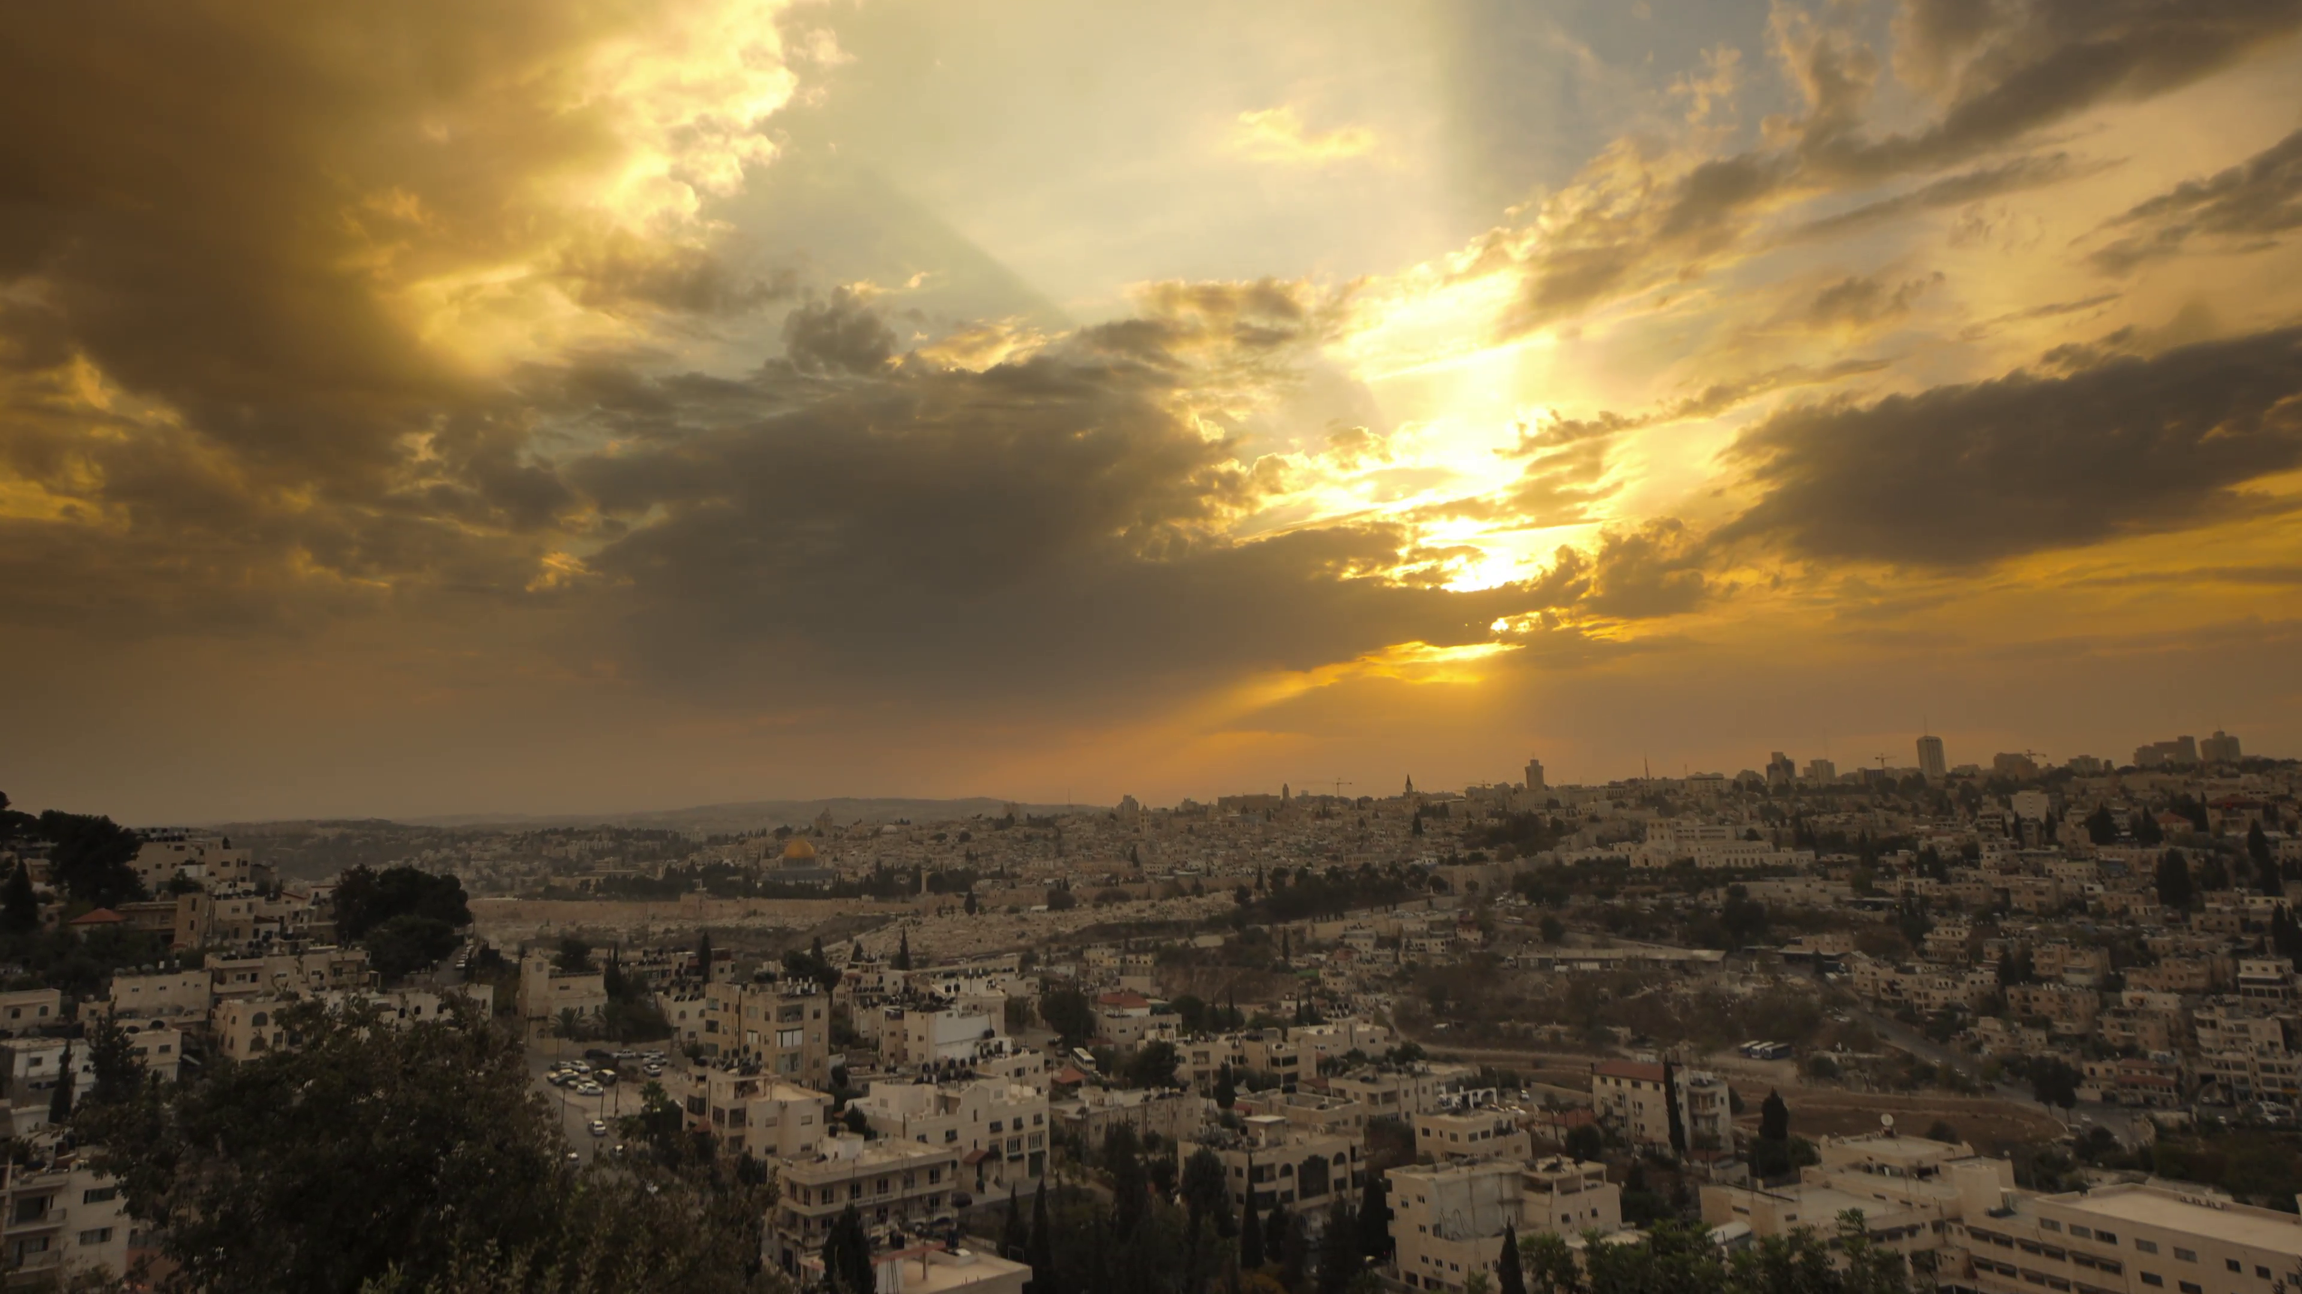
When morning comes,
I’ll walk the path,
That leads me to the tomb.
When morning comes,
My heartfelt wrath,
Just builds upon the gloom.

Slide 48
When morning comes,
The sun will shine,
And mock my broken heart.
When morning comes,
The birds will sing,
And then my tears will start.

Slide 49
When morning comes,
We’ll start our day,
Not knowing what to do?
When morning comes,
What could we say,
This crushing grief we knew.

Slide 50
When morning comes,
The sun will shine,
And mock my broken heart.
When morning comes,
The birds will sing,
And then my tears will start.

Slide 51
We stayed indoors,
We hid our face,
Shame had filled the air.
Alone and sad,
With such disgrace,
Our Lord no longer here.

Slide 52
When morning comes,
The sun will shine,
And mock my broken heart.
When morning comes,
The birds will sing,
And then my tears will start.

Slide 53
When morning comes,
The sun will shine,
And mock my broken heart.
When morning comes,
The birds will sing,
And then my tears will start.

Slide 54
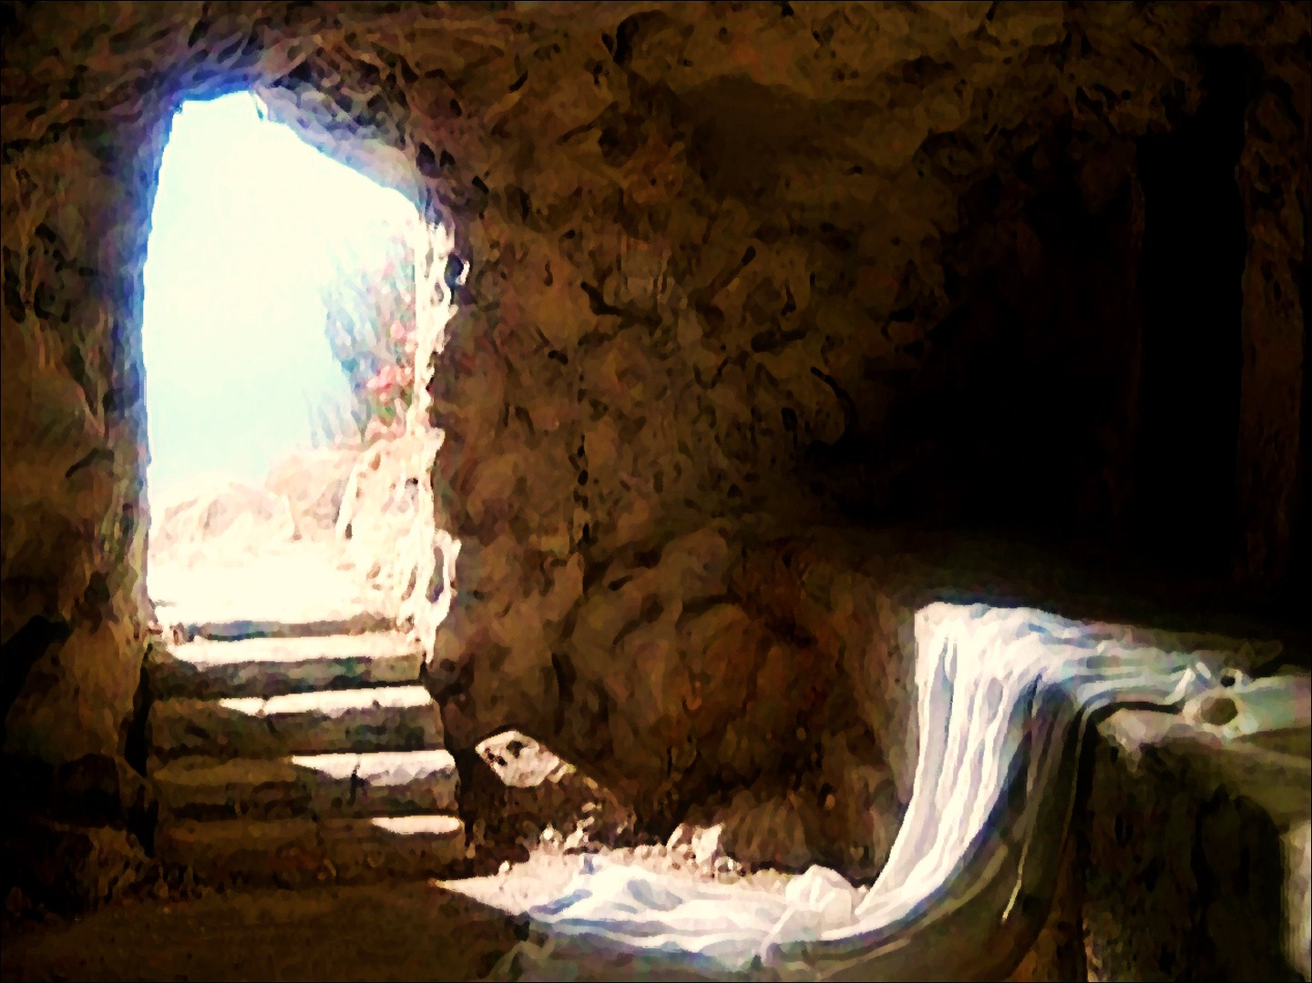
It’s Real.
He’s Alive!

Slide 55
The cold night has ended
The stone rolled away
The tomb is now empty
He’s gone from the grave
The past is behind me
The pain a memory
My risen Savior
Has now set me free

Slide 56
He’s alive! He’s alive!
Returned from the dead
He’s alive!
The power of sin
And the power of death
Conquered that morning
He drew His first breath
He’s alive! He’s alive!
Jesus is alive!

Slide 57
Death had held captive
My soul in its grasp
The chains that held me
Seemed forever to last
The power and light
The grave couldn’t contain
The captive released
Christ has broken the chain.

Slide 58
He’s alive! He’s alive!
Returned from the dead
He’s alive!
The power of sin
And the power of death
Conquered that morning
He drew His first breath
He’s alive! He’s alive!
Jesus is alive!

Slide 59
Satan had thought he had won
The cross had held God’s only Son
The stone rolled away
That bright sunny day
Jesus arose oh so strong

Slide 60
He’s alive! He’s alive!
Returned from the dead
He’s alive!
The power of sin
And the power of death
Conquered that morning
He drew His first breath
He’s alive! He’s alive!
Jesus is alive!

Slide 61
He’s alive! He’s alive!
Jesus is alive!
He’s alive! He’s alive!
Jesus is alive!

Slide 62

The Epilogue

Slide 63
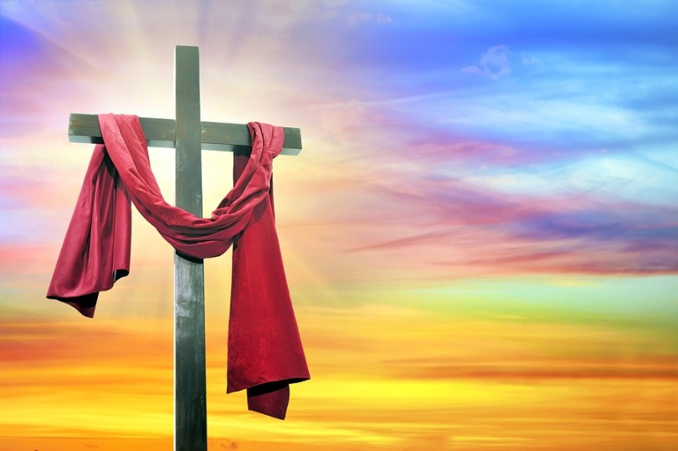
I carried His body,
And now He carries me.
I took Him off the cross,
From my sins
I'm now set free.
He rose on the third day,
With pow’r and victory!
I carried his body,
And now He carries me.

Slide 64
I carried His body,
And now He carries me.
I took Him off the cross,
From my sins
I'm now set free.
He rose on the third day,
With pow’r and victory!
I carried his body,
And now He carries me.

Slide 65
He’s alive! He’s alive!
Returned from the dead
He’s alive!
The power of sin
And the power of death
Conquered that morning
He drew His first breath
He’s alive! He’s alive!
Jesus is alive!

Slide 66
He’s alive! He’s alive!
Jesus is alive!
He’s alive! He’s alive!
Jesus is alive! (ENDING)

Slide 67
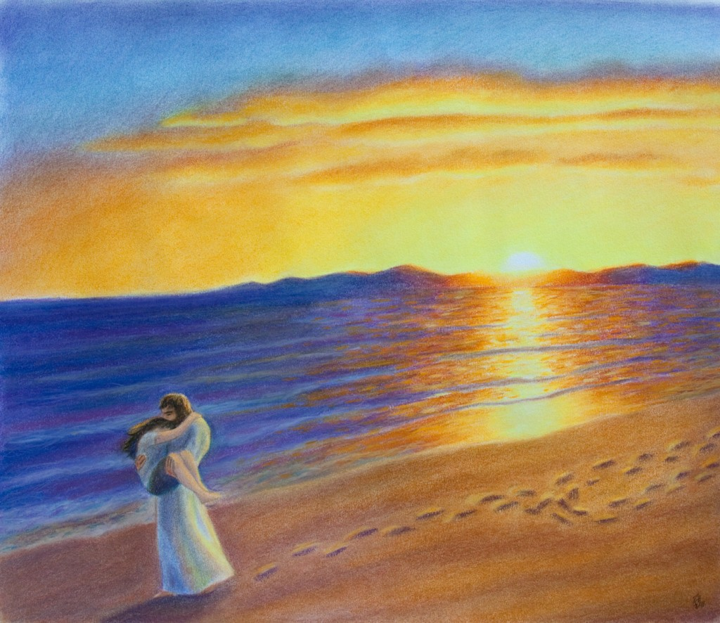
Closing Statement and Prayer

